Slide 1
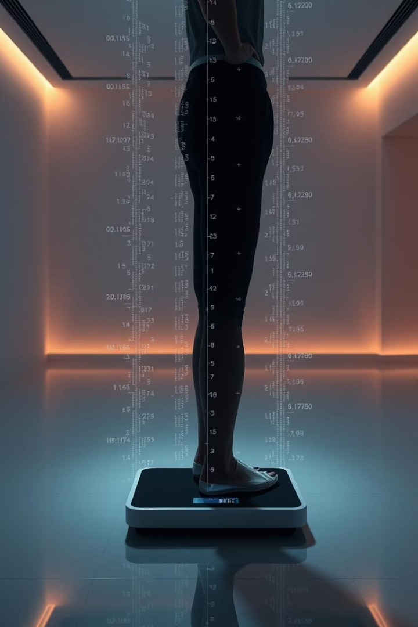
Obesity Classification Using Machine Learning
PRESENTED BY 2023-BSAI-004

Slide 2
INTRODUCTION
Objective: To classify individuals into weight categories ( Underweight, Normal Weight, Overweight, Obese ) using physical attributes (Age, Gender, Height, Weight, BMI) with supervised learning techniques.
Why This Matters: Early detection of obesity trends can help in designing targeted health interventions and promoting wellness strategies.
PRESENTED BY 2023-BSAI-004

Slide 3
Dataset
Source:
Obesity Classification Dataset
Size:
108 records, 7 columns
Features:
Age: Age of the individual
Gender: Male or Female
Height: In centimeters
Weight: In kilograms
BMI: Calculated Body Mass Index
Label: Target class (Underweight, Normal Weight, Overweight, Obese)
Class Distribution:
Underweight: 47
Normal Weight: 29
Overweight: 20
Obese: 12 ⚠️ Dataset is imbalanced.

Slide 4






Preprocessing Steps
Removed Irrelevant Columns
Dropped ID column
Handled Outliers
Applied IQR filtering to remove extreme values
Encoded Categorical Data
Used LabelEncoder for Gender and Label
Normalized Features
Applied StandardScaler
Dimensionality Reduction
Used PCA to retain 95% variance
Split Data
80% training / 20% testing

Slide 5
Modeling
Models Used:
Input:
Random Forest Classifier
PCA-transformed features
Ensemble of decision trees
Target:
Robust to overfitting and interpretable
MLP Classifier (ANN)
Encoded weight classification
Neural network with hidden layers (50, 30)
Trained for 1000 iterations

Slide 6
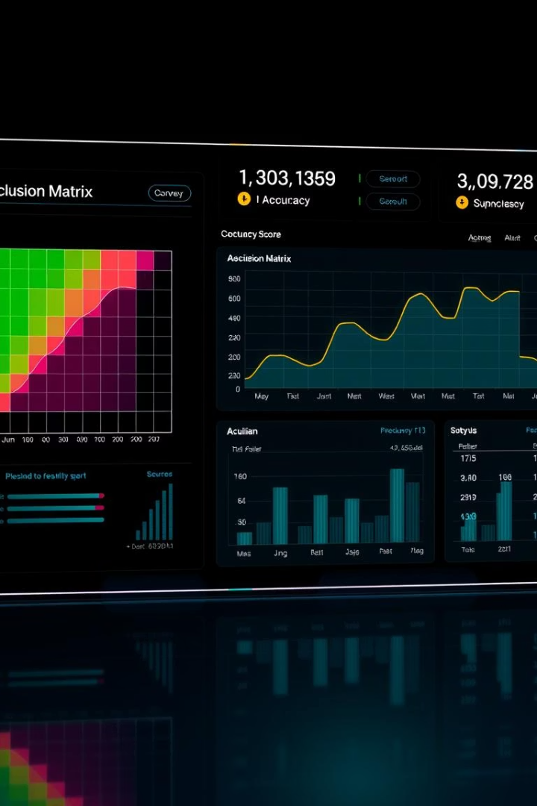
Evaluation
Metrics Used:
Confusion Matrix
Accuracy
Precision, Recall, F1-Score
Random Forest Results:
High precision for majority classes
Moderate misclassifications on minority classes
MLP Classifier Results:
Comparable accuracy to Random Forest
Slightly more sensitive to class imbalance
📉 Imbalance affects minority class predictions (especially “Obese”).

Slide 7
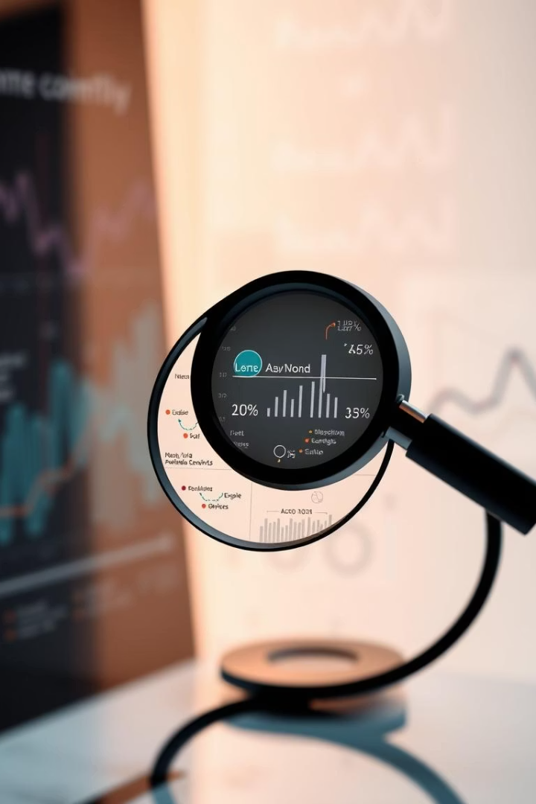
Key Findings
PCA reduced dimensionality without major loss of information
Random Forest slightly outperformed MLP in generalization
Class imbalance skewed predictions toward "Underweight" and "Normal"
Outlier removal and scaling significantly impacted performance

Slide 8
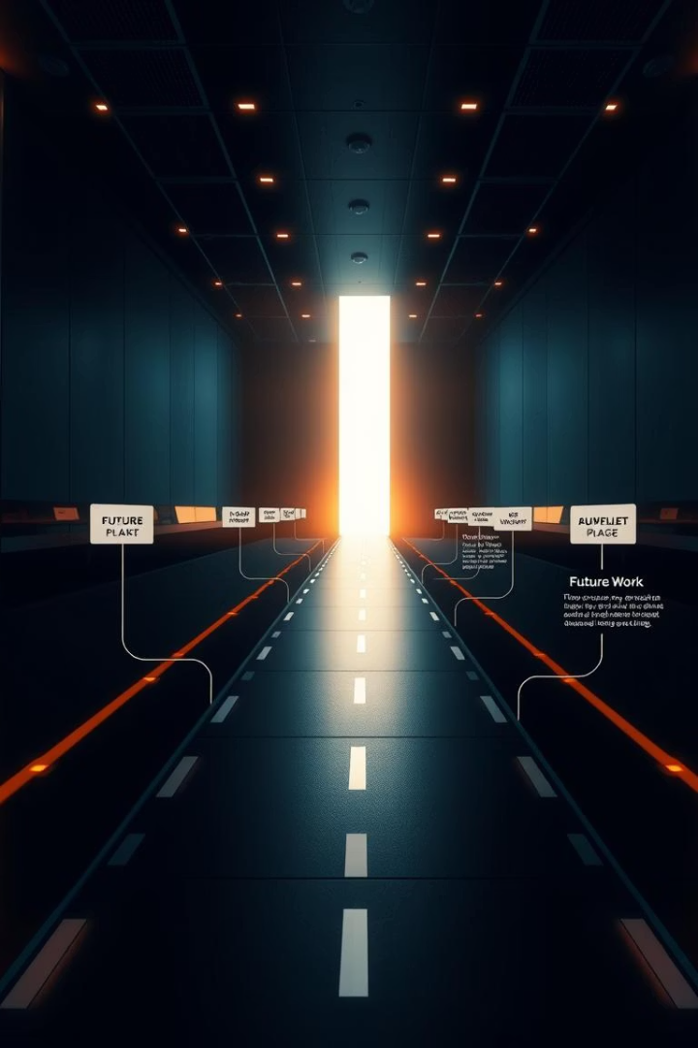
Conclusion
The project demonstrates a working ML pipeline for obesity classification.
Preprocessing, especially outlier handling and scaling, is crucial.
Data imbalance limits classifier performance—resampling or synthetic data is recommended.
Future work:
Use SMOTE or class weights, and experiment with other models (XGBoost, SVM).

